Slide 1
U.S. ARMY HUMAN RESOURCES COMMAND
Evaluation and Selection Systems
Notes:
1
Good morning. I am _______________, from ______________
Today I will present an information brief covering the Evaluation and Selection Systems to provide you with a better understanding of how the systems work and your roles as a Senior Rater or a Rater.
The information in this presentation is not guidance or policy. It is meant for training purposes.

Slide 2
System Facts
Purpose of Evaluations: Identify our Army’s best performers and those with the greatest potential
  Selection and Separation Boards and assignment managers are the audience
  Requires candor and courage; frank and accurate assessment
  Leaders must guard against “word inflation”…words matter most
  Allows for field impact on selection of future leaders
Both OER and NCOER are assessment tools …do not counsel on assessments
  OER is a forced distribution system
    Senior Rater top box restricted to <50%
    Rater left most box restricted to <50%
  OER Rater narrative focus on performance
  OER SR narrative focus on quantifiable potential
  NCOER SR bullets focus on excellence, performance & quantifiable potential
Selection & Promotion system is based on Army requirements
  Use the top box and quantified narratives to identify your best
  Cannot predict selection board results on Top Box/Most Qualified or Highly Qualified labels as selection boards decide based on a series of reports (the Whole File Concept)
Commander is overall care-taker of all personnel systems
Counseling is key to development
Notes:
Evaluation Systems Facts:
Bottom line: OER and NCOERs are tools to assess performance and potential (collectively they paint a picture of promotion potential)
For OERS, we have a Senior Rater managed profile which limits “Most Qualified” block check to less than 50%. **The narrative is crucial to communicate potential to a board.
For Raters, the RATER PROFILE is also a managed profile with a less than 50% limitation. Again, when reading or interpreting the raters intent, the narrative is expected to weigh most heavily in during board or assignment deliberations.
All HQDA selection boards are informed to use the “whole file” concept and not any individual report. Why??? Rating Officials have different philosophies, some have small rated populations or immature profiles and when reviewing multiple reports SIDE BY SIDE, a better assessment can be made. ( Consider this: If you have one OER, you have the opinion of one rater and one senior rater. If you read five or ten OERs, you will have the opinion of ten or twenty rating officials to inform your assessment)
Commanders approve the rating scheme……S1s assist and manage with Commander’s support.
Counseling (verbal/written) is key to provide expectation management. Keep on the right path….use support form.

Slide 3
Army Evaluation Reporting System
Who receives evaluation reports?
  Officers - Warrant Officer One through Brigadier General
  NCOs - Sergeant through Command Sergeant Major.
Two different Evaluation form series for two different
populations.
  Officer Evaluation Reporting System:
    Broader comparison, more of a generalist
    Doctrine Based, Tactical, Broadening – Strategic
  Noncommissioned Officer Evaluation Reporting System:
    Highlights Strengths and Uniqueness of the NCO Corps.
    Assess technical competence in MOS and Doctrine
    Responsible for individual training (Teach others the trade)
Evaluations Drivers:
CHANGE OF DUTY
CHANGE OF RATER
ANNUAL PERIOD (12 rated months)
COMPLETE THE RECORD (prior to selection boards)
RELIEF FOR CAUSE
Each report stands alone, assessments are made by supervisors in a rating relationship
Notes:
The Army Evaluation System is designed for all officers and noncommissioned officers and is designed to capture the rating official’s individual, stand alone, assessment of performance and potential over an evaluation period.
The evaluation system has been in existence since before WWII- it has undergone significant but needed changes as time and our missions change.
Generally, when a rater–rated Soldier relationship is established and then broken an evaluation report is rendered (If rater qualification standards are met). If the relationship lasts for 365 days (an annual period) an evaluation report is rendered. Or, if there is some other reason to render an OER or NCOER, it can be done. The most common reason for evaluation reports is change of rater.

Slide 4

Evaluation System Principles
Secondary effects of Eval System:
Maintain discipline
Promote leader development/professionalism by linking performance to missions and doctrine (assessed by field leaders)
Provide feedback to rated individuals
The System’s Components:
(as approved by CSA/SECARMY)
Rating relationship that exists between
Rater and Rated Soldier (w/oversight by
Senior Rater)
Counseling documented on support and
counseling forms.
Final assessment documented on
evaluation form.
Rating Roles:
RATER – Performance & Counseling
  Met Standards? Yes / No
  Narrow, more specific
SENIOR RATER – Potential & Mentorship
  Capstone evaluation, spread of quality
  Broader, more general
REVIEWER – adherence to policy & intent
  On OER: When required
  On NCOER: Separate individual
Critical Point:
Separating Rater and Senior Rater & keeping supervisors at lowest levels have been keys to success for over 32 years (since introduction of DA Form 67-8 and 2166-9)
“The eval is as important to the Army for the behavior it causes as for that which it measures.”
Notes:
The Army separates rating officials’ duties and responsibilities between the rater and the senior rater and has done so for the last two evaluation reporting systems.
The Army also keeps the level of the senior rater fairly close to the rated officer (normally two levels above rated officer or the Rater’s Rater is the Senior Rater).
The senior rater and rater are required to share their support forms (performance objectives) with the rated officer to properly link objectives toward a common mission and vision.
The rating officials are charged to develop Soldiers through counseling and interaction throughout the rating period.
Rating Officials assess and provide input to the Army on the performance and potential of all Soldiers using a series of box checks, information, and narrative comments.

Slide 5
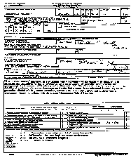


Moving Early OERs – What & Why
2LT / WO1 1LT CPT / CW3
POLICY
WO1 reports moved to restricted section of AMHRR after selection to CW3.
LT reports moved to restricted section of AMHRR at promotion to CPT.
  Officer Records Brief lists duty positions
All OERs are reviewed for CPT and CW3 selection.
May be accessed for selections in special circumstances
Notes:
The Army currently “masks” all 2LT and 1LT reports, at promotion to CPT, and WO1 reports upon selection to CW3. Masking is a euphemism for moving these OERs to the restricted section of the AMHRR (Army Human Resource Record) so they are not used for future career decisions (selections or assignments). The Army transitioned to this position first with 2LT reports and second with both 2LT and 1LT reports so board members may see a variety of files depending on the specific board.
Why? Officers enter the Army with varying levels of experience with military life. Their assignments and learning curves vary significantly and some officers experience “developmental” reports. l BUT... once the gate of specific promotion is passed, reports that may reflect an initial “learning curve” are masked. Removing them from the performance file or masking)may preclude an officer being disadvantaged later in his/her career.. NOTE ** Note however that REPORTS may be viewed when conducting Separation or Early Retirement Boards (or other Special Circumstances) The MILPER announcing the board will notify if the files will or will not be included.
History Notes (if asked):
For YG84 or older (i.e., 83, 82, 81..) nothing occurred.
For YG 85-86 – we masked 2LT reports (at the start of the new 67-9)
For YG 87 and younger (i.e., 88, 89, 90…) we masked both 2LT and 1LT reports
2014 CPT OSB included viewing masked reports

Slide 6
Strengthening the Rating Chain
Develop regulatory guidance to strengthen rating chain accountability
  Revised policy strengthens accountability within the rating chain to maintain relationships that provide rated officers with leaders who have first-hand knowledge of their responsibilities, performance and potential.
  Requires approval of rating schemes / one level up (up to 3-Star HQ)
  Intermediate Raters limited to special branches and dual supervisor situations
  Supplementary Review: When there are no uniformed Army designated rating officials for the Rated Officer, an Army Officer within the organization will be designated as a Uniformed Army Advisor and perform a supplementary review.
    The Uniformed Army Advisor will be an U.S. Army officer, normally senior to the senior rater, within the organization.
    The Uniformed Army Advisor will monitor evaluation practices, provide assistance and advice to rating officials (as required) on matters pertaining to Army evaluations.
      Applies in Joint Environments
      Applies where DoD and DA Civilians serve as Rater and Senior Rater
      Applies in multi-national environments
Unclassified
Notes:
-AR 623-3 and DA Pam 623-3 require that a Rated Officer’s “immediate” supervisor will be the Rater and the Rater’s Rater will be the Senior Rater. This is to provide rated officers with leaders who have first hand knowledge of the rated officer’s performance and potential
-Rating chains must be approved by the next higher headquarters up to the 3-star Level in order to eliminate pooling of officers.
-Intermediate Raters are limited to specialty branches and dual supervisory situations such as JAG, chaplains etc., some aviation units and where the Senior Rater does not meet minimum
table 2-1 Senior Rater rank requirements with regard to warrant officers.
For OERs-
AR 623-3 MAR 2014 Para 2-8 (2)
In instances when there are no uniformed Army designated rating officials for the rated officer, an Army officer within the organization will be designated as a Uniformed Army Advisor and perform a supplementary review. The Uniformed Army Advisor will be an U.S. Army officer, senior to the rated officer and normally senior to the senior rater, within the organization. The Uniformed Army Advisor will monitor evaluation practices, and provide assistance and advice to rating officials (as required) on matters pertaining to Army evaluations. This Uniformed Army Advisor will be designated by the CDR establishing the rating chain and identified in the published rating scheme at the beginning of the evaluation period. The memorandum will comment on the accuracy and/or clarity of the completed OER in accordance with this regulation. The comments will not include evaluative statements about the rated officer or statements that amplify, paraphrase, or endorse the comments and/or ratings of the rating chain
members. If there is no available U.S. Army officer or DA civilian above the senior rater in the chain of command, the senior rater or his or her BN and/or BDE S1 or administrative office will request an additional review by HQDA (see fig 2-3).

Slide 7
New OER (DA Form 67-10 / Supplementary Review)
In instances when there are no uniformed Army designated rating officials for the Rated Officer, an Army Officer within the organization will be designated as a Uniformed Army Advisor (UAA) and perform a supplementary review (IAW 623-3).
  The UAA will be an U.S. Army officer SENIOR to the rated officer within the organization. The UAA will monitor evaluation practices, provide assistance and advice to rating officials (as required) on matters pertaining to Army evaluations.
  Examples:
  Rated Officer Rater Senior Rater Uniformed Army Advisor
  CPT SES SES Yes; MAJ or higher
  VDAS Executive Officer (CPT), rated and senior-rated by a single SES.
  MAJ GS-15 SES Yes; LTC or higher
  ECC “Dwarf” (MAJ) is rated by GS-15 and senior-rated by SES.
  LTC SES SES Yes; COL or higher
  ASA (XXX) (LTC) is rated and senior-rated by a single SES.
  COL Navy ADM Air Force GO Yes; Senior COL or higher
  JS J-33 GFM Chief (COL) is rated and senior-rated by non uniformed Army officers.
Notes:
- This slide provides some examples of when A Uniformed Army Advisor would be required. NOTE Examples show UAA who are not Senior to the Senior Rater. The UAA should normally be senior to explain the context and impact of Army speak or the lack thereof..

Slide 8
Role of the Senior Rater & keys to success
Senior Rater is the “owner” of the Evaluation and is responsible for timely completion
Mentor/Develop your subordinates
  Support Form – tool available to aid in defining/guiding goals and objective throughout rating period, provides feedback to rated individual -not a lot of space but should be catalyst of conversation
Understand how our Evaluation Systems works
  Fairly and accurately assess subordinates -participate in counseling
  Senior Rater Narrative is key: Exclusive vs. Strong Narrative to describe subordinate
  Quantify potential…identify your best
  Be Careful… What you don’t say is just as damaging as what you do say
Verify/Certify your subordinates on how to assess – ask them to bring their counselings and assessment s with them to their counseling
Understand how to manage your Senior Rater profile - develop your rating philosophy
Anticipate and project “next” Evaluation
  Current thru date on file plus 12 months or known changes of rater
  Complete the record dates for those being considered by a board
Monitor when reports are required, that they’re submitted on time, and unit rating schemes are current and accurate (Leader responsibility)
  Use Interactive Web Response System (IWRS) and Evaluation Entry System (EES)
  Use EES and AKO MyForms to submit – be aware of sequencing during transition
Membership in the S1NET community helps https://www.milsuite.mil/s1net
Notes:
Keys to success:
Senior Raters are responsible for the evaluation & to identify the best…….also to identify those that may need some work.
Ultimately, selection boards use evaluations for promotion/separation decisions.
As leaders, we must mentor and share experiences with subordinates (How to write evaluations, manage profiles, know what right looks like).
Technique – When counseling those you rate, take the time to look over their counseling packets of their subordinates (who you Senior Rate) and discuss how & why they assess the way they do.
Read and reference Doctrine ADP 6.0 ,ADRP 6-22, AR 623-3 and DA PAM 623-3 and The Leader Development Guide published by the Center for Army Leadership..
HINT: The Leader Development Guide is an outstanding resource to understand relationship between the Attributes and Competencies and shows examples of strengths or developmental needs
Know tools to track evaluations (EES, ERS, S1 Net, read MILPER Messages)
Know how to assess – the narrative is key! Quantify Comments for your very best
Forecast, track, update evaluations and rating schemes….use EES and ERS to track and submit evaluations. The EES provides error prevention and profile management tools.

Slide 9
Role of the Rater
Raters must read, understand, and assess performance based on ADRP 6-22 Leadership Attributes and Competencies
Ensure rating schemes are published and understood
Provide Support Form and Counsel those you rate (mandatory)
Develop a “Rating Philosophy” and communicate it to rated officers
Advocate Officer to the Senior Rater
Recommend future Operational and Broadening Assignments on field grade form
Clearly and concisely communicate rated officer’s most significant achievements
Focus on narrative comments; selection board members use the rater’s assessment in their file deliberations
_________________________________
Anticipate and project future evaluations – When & Why?
Keep senior rating officials informed of upcoming evaluations
Track evaluations from submission to HRC thru completion
Notes:
AS a rater, you need you need to ensure fair and accurate assessments are completed (For the Army) and that counseling meets the needs of the rated Officer for feedback and understanding of performance objectives.
Above the line are things you should do
Below the line are the things the Rater and Senior Rater need to know to ensure that assessments are timely, accurate and meet the needs of the Army.
The raters role in any evaluation system is crucial to evaluating a rated officer’s performance during the rating period.
Raters must make a fair performance assessment using the Leadership Attributes and Competencies as defined in ADRP 6-22, Army Leadership. For those raters unfamiliar with ADRP 6-22, we recommend a thorough read and understanding of the attributes and competencies expected of leaders by grade. We also recommend taking time to read the Leader Development Guide from the Center for Army Leadership (CAL)
It is important to communicate/counsel with those you rate to ensure rating schemes are understood and support form is provided. The new support form is mandatory for WO1-COL. The Evaluation Entry System (EES) provides a tool for support form completion.
Like the Senior Rater, it is also important to anticipate/project preparation of evaluations and keep senior raters informed of upcoming evaluations. No Surprises! Once an evaluation is submitted to HRC, raters must track it through completion in EES. Also, raters can make recommendations on future Operational, Broadening, and Strategic Assignments for field grade and strategic officers. Look to DA PAM 600-3 and 600-4 (AMEDD) for ideas of the career path
HINT:
When you counsel and use a Support Form, it is easier to track and sort the rated officer’s most significant accomplishments (what they did and how well they did it) from the completed support form and associate them with the respective attribute and competency as defined in ADRP 6-22. Then, concisely write the narratives. Raters and senior raters can and should comment on officers ability to employ mission command principles in narrative comments. Mission command principles are incorporated in ADRP 6-22 as well.

Slide 10
Developing a Rating Philosophy
Mission: Identify your best
Counseling – ensure counseling is accomplished. Those that can improve will
Decide how to assess (particularly) Excels based on performance and Most Qualified Based upon Potential
Write well – quantify and qualify in narrative; correspond comments with box check as the system allows. Use the narrative to paint the picture
Plan ahead, think series of reports (number of times you will rate an officer)
15
Notes:
Rating Officials should develop and communicate their philosophy for those they rate. Rating Officials should communicate what right looks like to subordinates and let them know where they stand. The purpose of counseling is to provide feedback about how well they are doing and ways to improve- think of counseling and support from use as a Leadership In Progress Review (IPR) and the Evaluation as the AAR. Completing IPRs ensures a better outcome.
TAKE SOME TIME AND DECIDE What are your personal limits for EXCELS or MOST Qualified Indications. Will it be all tasks on time and to standard or just some?, PT must be270 or higher? A foundational understanding of Mission Command and MDMP? Or those who can understand implied tasks, take the initiative and at least defend their position- if they are overridden, do they march on or fight every step? Able to think out of the box?
The Army generally does not use all available space in a profile- Most Senior Raters maximum is 42% by grade or lower. Why? Because when something occurs out of the norm -a new task org, a special board, HRC Directed OERs, they have the room to take care of the best. HIGHLY recommend that you maintain room in your profile.
HINT:
When you counsel and use a Support Form, it is easier to point out to the officer why you are giving them a Highly Qualified or a Proficient indication – they will know it before you actually write the report- the key is to teach them what right looks like..
Use your narrative to communicate and quantify performance compared to other officers you have rated in your career. Once you as a rating official decide on you philosophy, stick to it. Remember- Identify your best and hold those not performing accountable in your rating.

Slide 11
Evaluation Narrative
Selection boards should understand what input the Rating Chain is providing without having to guess
Raters focus on specifics to quantify and qualify performance
Senior raters need to amplify their potential box checks by using the narrative to clearly send the appropriate message to selection boards. Focus on potential (3 to 5 years; command, assignment, schooling and promotion)
Cannot mention Box Check in the narrative
Be careful with your narrative:
  - What is not said can have the same impact as what is said
  - Don’t say the same thing for all your people (Boards can easily detect repeated verbiage)
  Avoid using the same verbiage year to year for the same officer (modified cut and paste)
  Accurately and fairly assess all officers regardless of branch and functional area
  Don’t be afraid of Referred Reports
Notes:
Remember you target audience – Boards (Selection and Separation) should understand what input the Rating Chain is providing without having to guess.
Raters should focus on specifics to quantify and qualify performance
Senior raters need to amplify their potential box checks by using the narrative to clearly send the appropriate message to selection boards. Focus on potential (3 to 5 years; command, assignment, schooling and promotion)
You cannot mention the block check in the narrative! You cannot say, “I would give this officer an Excels box check if I had the profile to support.”
Be careful with your narrative:
- What is not said can have the same impact as what is said
- Don’t say the same thing for all your people (Boards can easily detect repeated verbiage)
Avoid using the same verbiage year to year for the same officer (modified cut and paste)
Accurately and fairly assess all officers regardless of branch and functional area
Don’t be afraid of Referred Reports however, if you don’t think they are failing but are below average, use the qualified box..
IMPORTANT*** The intent of the third box is to identify the below average performers who are technically qualified but merit the third box (below average) for potential. This population would probably not be large. The box would equate in the old system to the COM with a neutral/weak narrative. It does not refer the report. This non referral was implemented as many Senior Raters
indicated they wanted to not refer a report but needed to clearly articulate the officer is below average. If the narrative uses terms like "failed to“ or "struggles with" coupled with a QUALIFIED indication, it might require referral.
In the next slides I will show some correlations of narrative to box check.

Slide 12
Rater Narrative (Exclusive)
Rater overall assessment of rated officer’s performance compared to officers in same grade
  Limited to Company and Field Grade forms
e. This Officer’s Overall Performance is Rated as: (Select one box representing Rated Officer’s overall performance compared to others of the same grade whom you have rated in your career. Managed at less than 50% in EXCELS.) I currently rate__9__ Army Officers in this grade.
EXCELS
(49%)
EXCELS PROFICIENT CAPABLE UNSATISFACTORY
()
X
OR
Comments:
MAJ Smith’s performance is clearly the best of the 9 majors I currently rate, and his performance ranks within the top 1% of majors with whom I’ve worked or encountered in over 20 years of service.
Use of exclusive narrative should be used to amplify box checks and in instances where small or immature
profiles exist; or on a proficient indication following an excels ( if warranted)
Excels Defined:
Results far surpass expectations. The officer readily (fluently/naturally/effortlessly) demonstrates a high level of the all attributes and competencies. Recognizes and exploits new resources; creates opportunities. Demonstrates initiative and adaptability even in highly unusual or difficult situations. Emulated; sought after as expert with influence beyond unit. Actions have significant, enduring, and positive impact on mission, the unit and beyond. Innovative approaches to problems produce significant gains in quality and efficiency.
Unclassified

Slide 13
Rater Narrative (Strong)
Rater overall assessment of rated officer’s performance compared to officers in same grade
  Limited to Company and Field Grade forms
e. This Officer’s Overall Performance is Rated as: (Select one box representing Rated Officer’s overall performance compared to others of the same grade whom you have rated in your career. Managed at less than 50% in EXCELS.) I currently rate_9___ Army Officers in this grade.
EXCELS
(49%)
EXCELS PROFICIENT CAPABLE UNSATISFACTORY
()
X
Comments:
MAJ Smith performs within the top third of the majors I currently rate, and his performance ranks within the top 10% of majors with whom I’ve worked or encountered in over 20 years of service.
Proficient:
Consistently produces quality results with measurable and lasting improvement in unit performance. Consistently demonstrates a high level of performance for each attribute and competency. Proactive in challenging situations. Habitually makes effective use of time and resources; improves position procedures and products. Positive impact extends beyond position expectations.
Unclassified

Slide 14
Rater Narrative
Rater overall assessment of rated officer’s performance compared to officers in same grade
  Limited to Company and Field Grade forms
e. This Officer’s Overall Performance is Rated as: (Select one box representing Rated Officer’s overall performance compared to others of the same grade whom you have rated in your career. Managed at less than 50% in EXCELS.) I currently rate_9___ Army Officers in this grade.
EXCELS
(49%)
EXCELS PROFICIENT CAPABLE UNSATISFACTORY
()
X
Comments:
MAJ Smith’s performance over this rating period has been commensurate with his grade and time in service. He has completed all assigned tasks to standard in a timely manner, and he is able to manage complex assignments. A critical thinker who works well with others.
Capable:
Meets requirements of position and additional duties. Capable of demonstrating Soldier attributes and competencies and frequently applies them; Actively learning to apply them at a higher level or in more situations. Aptitude, commitment, competence meets expectations. Actions have a positive impact on unit or mission but may be limited in scope of impact or duration.
Unclassified

Slide 15
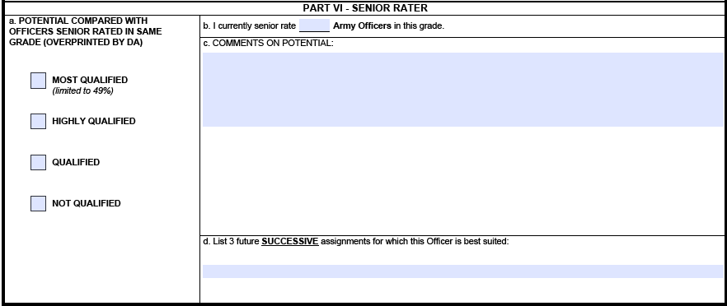
Senior Rater Narrative (Exclusive)
27
27
MAJ Smith is my #1 major of the 27 I currently senior rate, and one of the best officers that I’ve seen in over 25 years of service—top 1%. Already shows Battalion Command potential, a must-promote BZ to LTC and Battalion Command. Send to SSC at the earliest opportunity—a future senior leader in the Corps and the Army.
X
EXCELS
(49%)
()
EXCELS
(49%)
BN Commander, CMTC OC, TSC G4
()
Use of exclusive narrative should be used to amplify box checks and in instances where small or immature
profiles exist; or on a HIGHLY QUALIFIED indication following a MOST QUALIFIED ( if warranted)
MOST QUALIFIED: Strong potential for BZ and CMD; potential ahead of peers
Unclassified
Notes:
This is an example of an exclusive Senior Rater Narrative

Slide 16
Senior Rater Narrative (Strong)
27
27
MAJ Smith is my #4 major of the 27 I currently senior rate, and one of the best officers that I’ve seen in over 25 years of service— easily top 10%. Already shows Battalion Command potential; promote to LTC and select for Battalion Command followed by SSC.
EXCELS
(49%)
()
X
EXCELS
(49%)
()
BN Commander, CMTC OC, TSC G4
HIGHLY QUALIFIED: Strong potential for promotion with peers
Unclassified

Slide 17
Senior Rater Narrative
27
27
MAJ Smith has clearly demonstrated the potential to continue to serve at this grade. Bob possesses outstanding writing skills that would support developing instructional manuals. Consider for promotion.
EXCELS
(49%)
()
X
Brigade Staff, Division Staff, IMCOM
EXCELS
(49%)
()
MOST QUALIFIED: Strong potential for BZ and CMD; potential ahead of peers
HIGHLY QUALIFIED: Strong potential for promotion with peers
QUALIFIED: Capable of success at the next level; promote if able
NOT QUALIFIED: Not recommended for promotion
Unclassified

Slide 18
What do boards focus on?
3 Parts to a Board file
DA Photo
ORB
AMHRR (OERs, Disciplinary Data, Awards, AER)
Quantified and Qualified, Descriptive Strong vs. Exclusive
1. Senior Rater Section:
- Narrative
- DA Label Information (if applicable)
- Population Size
2. Duty Description
3. Number of Rated Months
Rater Narrative
- Narrative
- DA Label Information (if applicable)
- Population Size
5. Intermediate Rater Narrative (if used)
Notes:
Now that you have a basic understanding of the Evaluation system and rating chain roles and responsibilities, lets look at how that information is used ( BY BOARDS)
There are three parts to a board file Photo, ORB and the AMHRR – because these represent you at the board, we highly recommend that all are squared away- current photo, up to date orb and all of your evaluations are present- your verification of your Board File ( My Board File shows you have looked at your file and it is good to go to represent you at the board.
Board members typically look at the Senior Rater narrative and read the comments on performance, potential and recommended schooling or future positions. In post board surveys, board members list the senior rater section (specifically the narrative) as the single most important element in helping them determine how to vote a file.
Next most important is the senior rater label and associated information (if it applicable for the rated officer’s rank). This provides the name of the rated officer, the senior rater’s name, the date of the rating, the total number of ratings this Senior Rater has completed, and the number of times this officer has been senior rated by the same individual, as well as any corresponding Block Check. An additional factor that board members look at when there is a block check is the Senior Rater Population size. This helps them determine if the senior rater has a small population, and might be limited in being able to give MOST QUALIFIED indication due to low numbers of officers in the rating population. I’ll show you later how that works.
Board members next look at the Duty Description in helping to determine the scope of responsibility of the officer and the length of the OER (the number of rated months). Additionally, the number of rated months on an OER helps to determine the weight that it may carry with a board member. Board members understand that there are times when a 3 month OER may be required by regulation, and that the amount of time that the rater and senior rater have had to formulate comments on performance and potential is different than is the rating period is for 12 months. Board members also list the rater’s narrative as that final confirmation in looking at comments on performance, potential, and future schooling and positions.
Most notably, board members are able to determine when a senior rater is attempting to write a strong narrative versus an exclusive narrative like we discussed earlier. This helps weight the evaluations. Senior rater narratives should be quantified, qualified descriptive narratives of the senior raters passion, or lack thereof, for the rated officer.

Slide 19
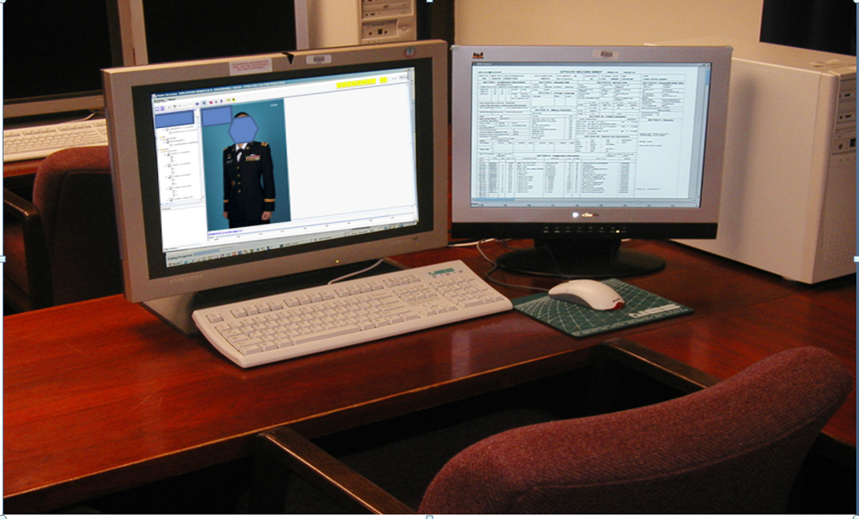
Army Selection Board System
Notes:
Here is the dual monitor ASBS file review system that board members use.
Note the ORB is Visible on the right, Your Photo is immediately up front, and on the left are all of you OERS, Awards and Disciplinary data.
This set up allows Board Members to quickly move through and VOTE on a file.
Boards Members are made up of a representative population of the Army, are Senior in grade to the Board Eligible population and in sufficient numbers to remove any possible bias.

Slide 20
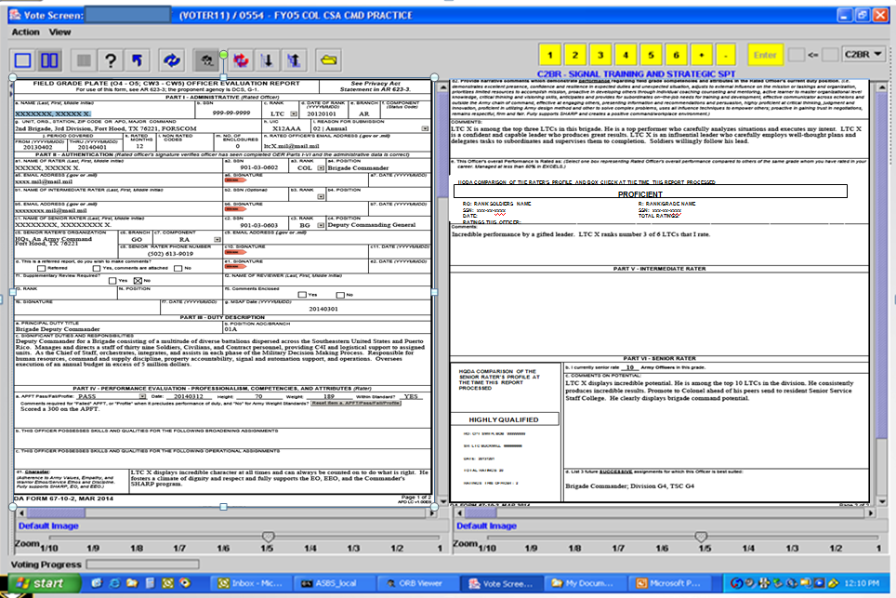
Board Screenshot
Notes:
This is an Evaluation screenshot- board members can see both sides at one time.

Slide 21
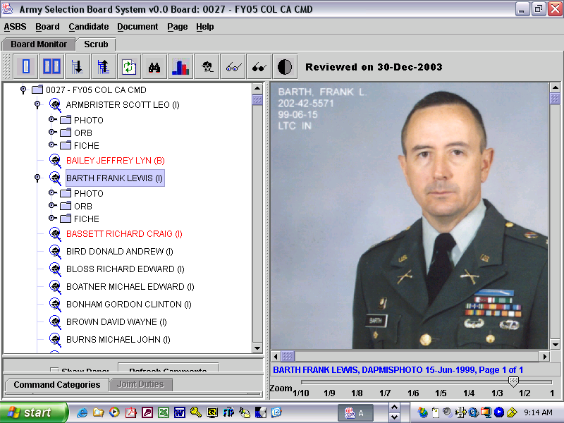


Board Member Voting
+
Word Picture
1 - 6+
MOI
+
+
SEC ARMY’s MEMORANDUM OF INSTRUCTION
BOARD FILE:
Official Photograph
Officer Record Brief
Official Military Personnel
File (evaluation reports,
awards, etc)
SCORING
CRITERIA
BOARD MEMBER EXPERIENCE & JUDGMENT
= VOTE
Notes:
24
DA Secretariat opens board
Administers board oath
Presents briefings; OER, QMP, and SEC ARMY MOI
Conducts practice vote
Board members prepared to vote file
The board members use The MOI, Board File, their experience and judgment to determine a score for each file which is their vote. If any Board Member is statistically out (either very high or very low) compared to the other voting members, they are directed to revote the file.

Slide 22
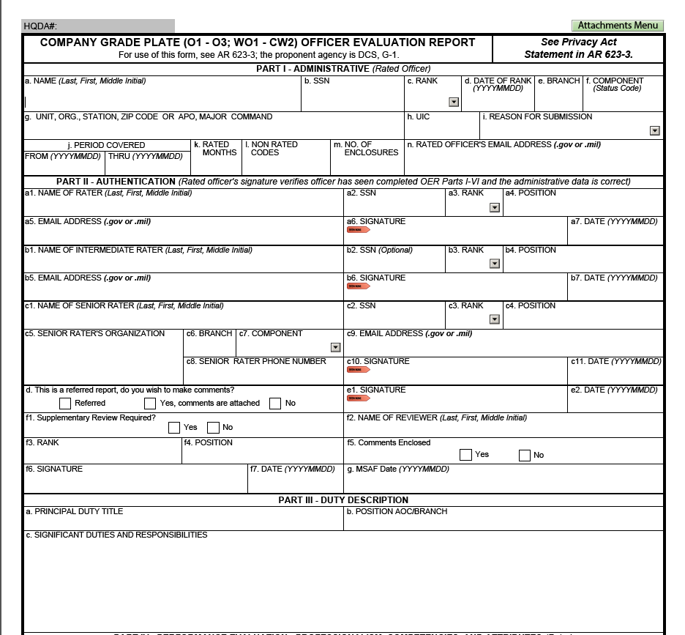
OER Administrative Data -- PARTS I, II, III
ALL OERS HAVE THE SAME ADMIN DATA
MSAF Completion date valid within 3 years
Notes:
Board members receive instruction (which is not guidance on where to look on the OER….
“The OER front side, top half, contains several key areas of importance which are highlighted in red”:
1-The type of evaluation (Change of Rater, Annual, Complete the Record, etc.) and the number of evaluated months.
2- Combine this period with the duty title and job description;-- board members normally get what they need to weight an individual OER.
The duty description should explain the scope and responsibilities so that those members unfamiliar with this branch or functional area can understand what the officer did and what he/she was supposed to do. (When writing, don’t use acronyms.)
3- In the administrative section, the rated officer signs last indicating that he/she has seen the completed form. OERs may have a combination of CAC and ink signatures.
4- A “referred” report, or a report with negative information, is annotated with a box check and the rated officer annotates whether or not a response will be submitted. Any comments from the rated officer in response to the OER will be posted next to the OER in the OMPF. A referred box check eliminates formal referral letters (unless the rated officer was contacted by mail.)
5- Note the space to enter the supplementary review information on the front of the form. This is used when there is no uniformed Army designated rating official for the rated Officer (there needs to be at least one). If not, a supplementary review will be performed by the first U.S. Army officer above (normally) the senior rater in the organization or chain of supervision. This officer will be designated as the Uniformed Army Advisor by the CDR establishing the rating chain and identified in the published rating chain.
6- The MSAF 360 date box is an added field and replaces the need for a required statement in the raters narrative. It the completions date of the MSAF (REF AR350-1) and is good for 3 years. Lack of a date will not in and of itself refer the report- that is the Rating Chain’s call.
7- Senior rater’s telephone number and e-mail address are reflected on the OER to help HRC eliminate discrepancies or errors.

Slide 23
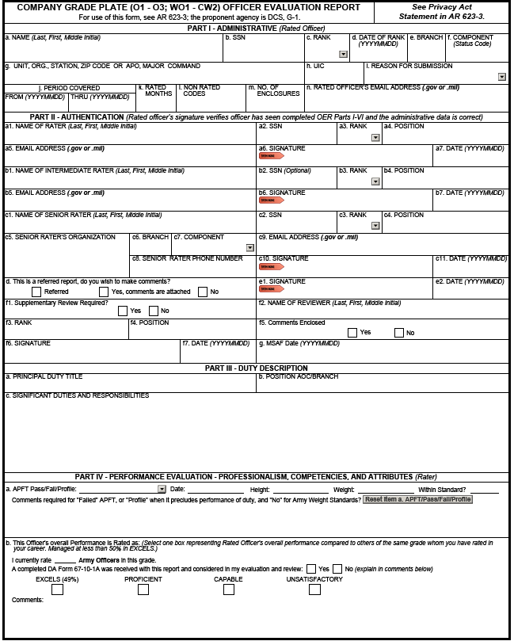
Part IV – Professionalism (Company Grade Form front side continued)
Company Grade Form (front)
Rater overall assessment of rated officer’s performance compared to officers in same grade
Limited to Company and Field Grade plates
b. This Officer’s Overall Performance is Rated as: (Select one box representing Rated Officer’s overall performance compared to others of the same grade whom you have rated in your career. Managed at less than 50% in EXCELS.) I currently rate__5__ Army Officers in this grade.
EXCELS
(49%)
HQDA COMPARISON OF THE RATER’S PROFILE AND BOX CHECK AT THE TIME THIS REPORT PROCESSED
EXCELS
()
PROFICIENT
CAPABLE
UNSATISFACTORY
PROFICIENT
RO: CPT SMITH, J
SSN: xxx-xx-xxxx
DATE: 20140101
RATINGS THIS OFFICER: 1
R: LTC BOREK, B
SSN: xxx-xx-xxxx
TOTAL RATINGS: 1
Comments:
NORM
CPT Smith's performance as a Company Commander has been superb. Joe demonstrated superior leadership and understanding of all aspects of command. Additionally, CPT Smith has highly advanced organizational skills and leadership ability.
b. This Officer’s Overall Performance is Rated As: (Select one box representing Rated Officer’s Overall performance compared to others of the same grade whom you have rated in your career. Managed at less than 50% in EXCELS.) I currently rate _______ Army Officers in this grade.
EXCELS(49%)
PROFICIENT
CAPABLE
UNSATISFACTORY
Comments:
Notes:
This slide shows the front side of a Company Grade OER- The callout demonstrates the box checks that a Rater can select with regard to the rated officer’s performance as compared to all of the officers the Rater has rated throughout his/her career and the label applied by HQDA after comparing the rater’s indication of performance to the rater’s profile record.
The label will contain the Rated Officer’s name, date the evaluation was submitted to HQDA, the number of ratings for this officer, and the total number of ratings for officers in this grade.
**NOTE** Unlike the old OER (DA 67-9) where left justified reports were common, the new OER limits use of the left most (Excels) box to less than 49%. As a rating official, recommend that you maintain a “buffer” of your “TOP BOX” for Senior Raters this means have room in your profile for Most Qualified and for Rater’s room for Excels indications. Not having room when you need it won’t be a problem if you maintain a buffer.

Slide 24
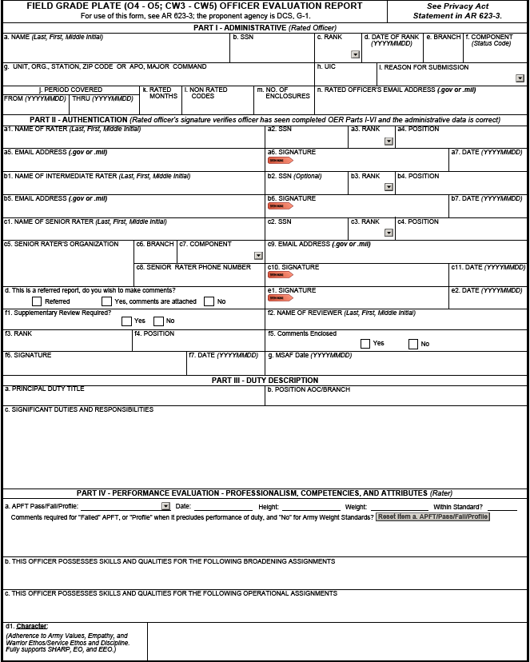
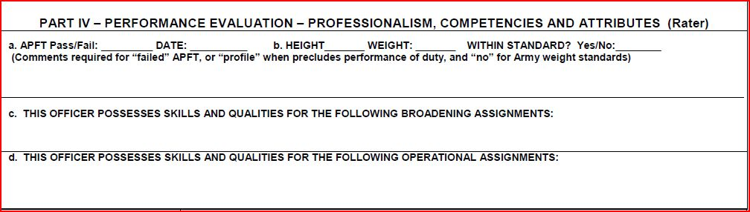
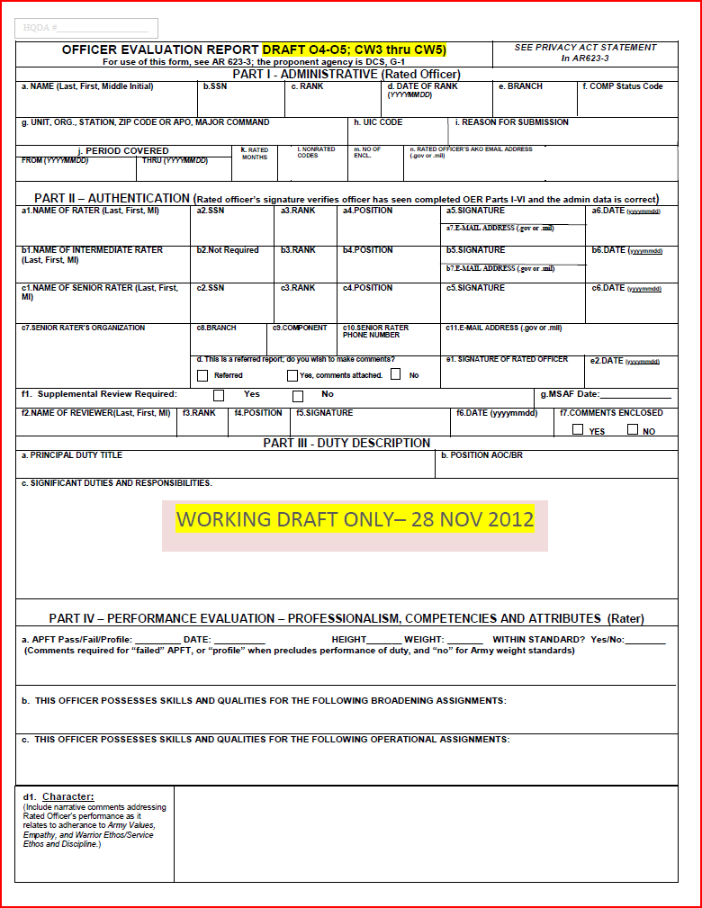
Field Grade Form O4/O5; CW3-CW5 (front)
Joint/COCOM Staff, CTC O/C, Assistant PMS (REF DA PAM 600-3/600-4)
BDE XO, Division/Corps Staff, ASCC Staff (REF DA PAM 600-3/600-4)
Notes:
The front of a field grade form is different. The Rater box checks are moved to the back and on the Field Grade form, a recommendation for broadening and strategic assignments is Recommended US DA PAM 600-3 and 600-4 (AMEDD) for guidance when selecting broadening and operational assignments. Some examples of Broadening examples are in the back up section of this brief. If you have more questions, contact your branch manager for advice.

Slide 25
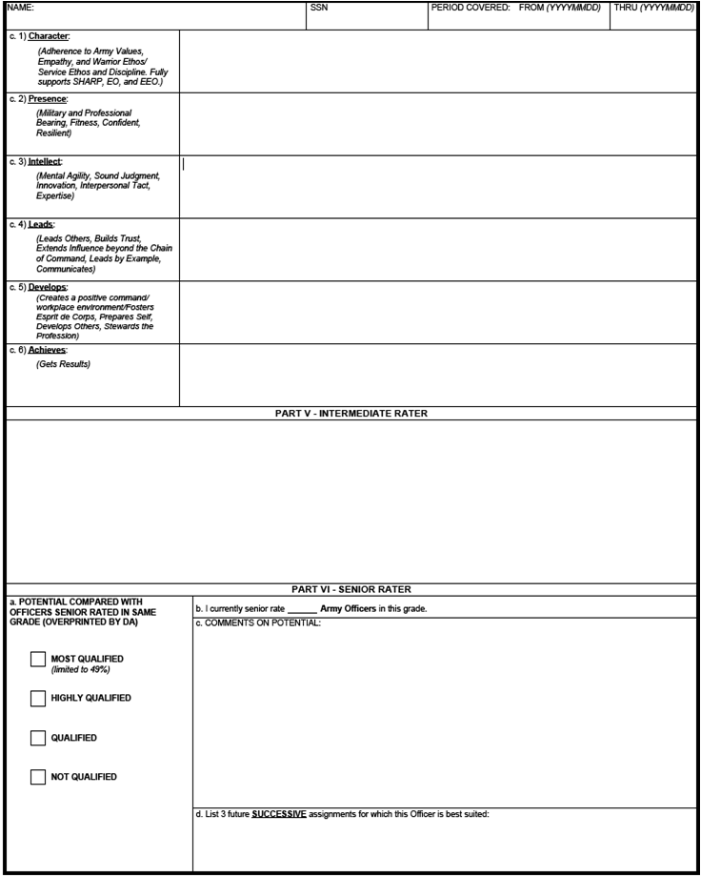
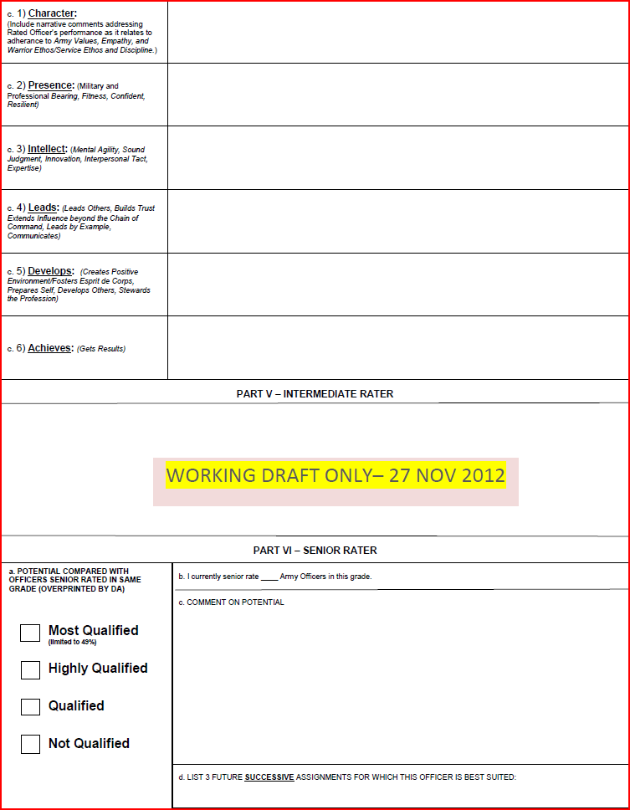
Rater Assessment:
Company Grade Plate 2LT-CPT; WO1-CW2
Focused on core attributes and competencies in ADRP 6-22
More prescriptive
Performance based assessment
Narrative only (3-4 lines per entry)
Encourages specific discussion with rated officer on desired traits
1) Character:
(Adherence to Army Values, Empathy, and Warrior Ethos/Service Ethos and Discipline. Fully Supports SHARP, EO and EEO)
CPT Smith embodies the Army Values in all that he does. Joe tactfully instills discipline and the Warrior Ethos in his subordinates to the highest standards. He uses sound, informed judgment and upholds high ethical standards when planning, preparing, and executing operations. He fosters a climate of dignity and respect, and fully supports the EO, EEO, and the Commander's SHARP program.
2) Presence: (Military and Professional Bearing, Fitness, Confident, Resilient)
CPT Smith displays confidence and enthusiasm while projecting a positive command presence that permeates throughout his unit as evidenced by his company’s APFT average of 275, the best in the brigade. Joe possesses the ability to handle stressful situations and maintain a professional military bearing when faced with adversity.
Comments on performance – not potential
Notes:
The Second page of thee Company Grade form is broken down into 6 different areas where the Rater will write up to “four” lines of narrative for the leadership attributes and competencies which align with the Support Form and Army Doctrine Publication (ADRP) 6-22. This is an example of CHARACTER and PRESENCE.. For a company grade report
Note The Intermediate Rater comments block will only be utilized for special branches that require dual supervision/advisory such as Chaplains and JAG officers etc. Intermediate Raters may enter up to “five” lines of narrative comments where they will address both “Performance” and “Potential.”

Slide 26
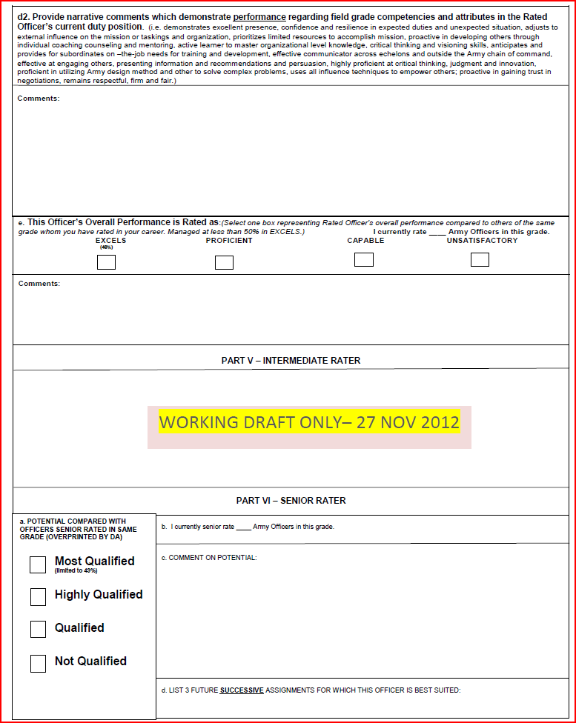
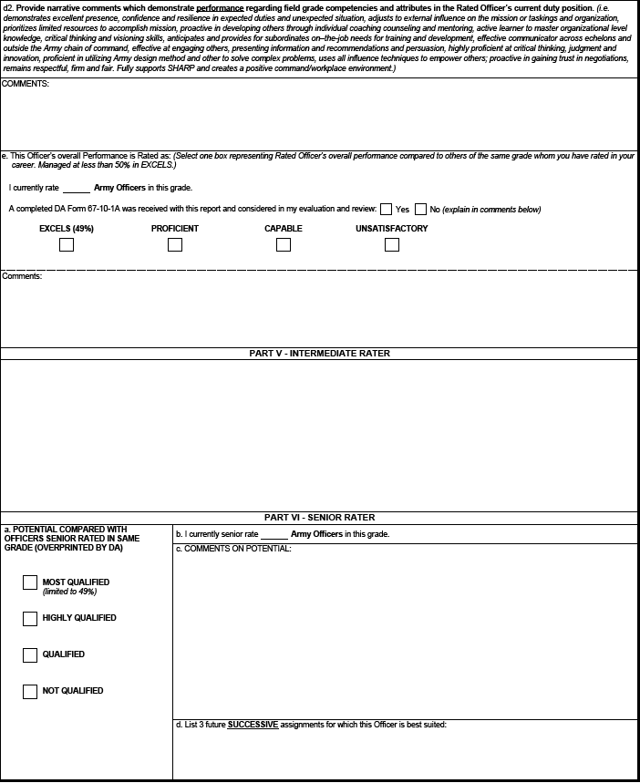
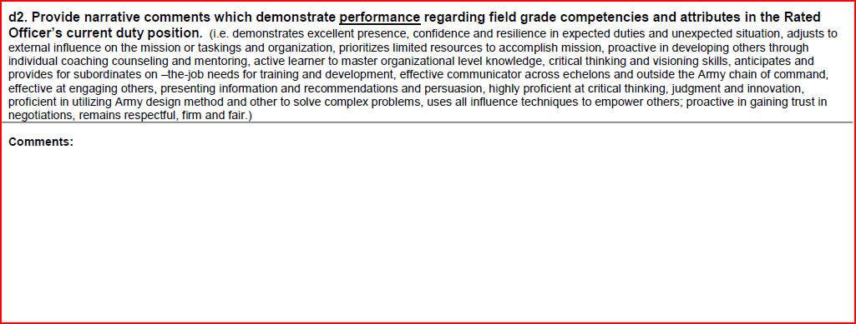
Field Grade Form O4/O5; CW3-CW5 (back)
LTC X is a top performer who unfailingly analyzes situations and executes my intent. Joe is a confident and capable leader who, regardless of obstacles, always produces great results. LTC X is an influential leader across the brigade who carefully employs well-thought plans and delegates tasks that empower his subordinates with the authority to complete. Soldiers willingly follow his lead.
Notes:
This is an example of the Field Grade form

Slide 27
Part IV – Professionalism (Field Grade Form Back )
Company Grade Form (front)
Rater overall assessment of rated officer’s performance compared to officers in same grade
Limited to Company and Field Grade plates
LTC X is among the top three LTCs in this brigade. He is a top performer who carefully analyzes situations and executes my intent. LTC X is a confident and capable leader who produces great results. LTC X is an influential leader who carefully employs well-thought plans and delegates tasks to subordinates and supervises them to completion. Soldiers willingly follow his lead.
b. This Officer’s Overall Performance is Rated as: (Select one box representing Rated Officer’s overall performance compared to others of the same grade whom you have rated in your career. Managed at less than 50% in EXCELS.) I currently rate__5__ Army Officers in this grade.
b. This Officer’s Overall Performance is Rated As: (Select one box representing Rated Officer’s Overall performance compared to others of the same grade whom you have rated in your career. Managed at less than 50% in EXCELS.) I currently rate _______ Army Officers in this grade.
EXCELS(49%)
PROFICIENT
CAPABLE
UNSATISFACTORY
Comments:
EXCELS
(49%)
HQDA COMPARISON OF THE RATER’S PROFILE AND BOX CHECK AT THE TIME THIS REPORT PROCESSED
EXCELS
()
PROFICIENT
PROFICIENT
CAPABLE
UNSATISFACTORY
RO: LTC SMITH, J
SSN: xxx-xx-xxxx
DATE: 20140101
RATINGS THIS OFFICER: 1
R: COL BOREK, B
SSN: xxx-xx-xxxx
TOTAL RATINGS: 1
NORM
Comments:
Joe is the best of 5 Battalion Commanders in this Brigade. Joe demonstrated superior leadership and understanding of all aspects of command.
Notes:
This slide shows the front side of a Company Grade OER- The callout demonstrates the box checks that a Rater can select with regard to the rated officer’s performance as compared to all of the officers the Rater has rated throughout his/her career and the label applied by HQDA after comparing the rater’s indication of performance to the rater’s profile record.
The label will contain the Rated Officer’s name, date the evaluation was submitted to HQDA, the number of ratings for this officer, and the total number of ratings for officers in this grade.
**NOTE** Unlike the old OER (DA 67-9) where left justified reports were common, the new OER limits use of the left most (Excels) box to less than 49%. As a rating official, recommend that you maintain a “buffer” of your “TOP BOX” for Senior Raters this means have room in your profile for Most Qualified and for Rater’s room for Excels indications. Not having room when you need it won’t be a problem if you maintain a buffer.

Slide 28
Senior Rater Comments
Senior Rater Comments are mandatory.
Have up to 5 lines of narrative text to comment on Potential only.
This field captures the Senior Rater’s passion (or lack thereof) for the rated officer
Use exclusive narrative, enumeration & recommendations for promotion, schooling, command recommendation for Most Qualified Potential Indications.
Use strong narrative for use of Highly Qualified indications and consider promotion, schooling, command recommendation.
Remember, what is not said can have as much impact as what is said.
LTC X is a top performer who unfailingly analyzes situations and executes my intent. Joe is a confident and capable leader who, regardless of obstacles, always produces great results. LTC X is an influential leader across the brigade who carefully employs well-thought plans and delegates tasks that empower his subordinates with the authority to complete. Soldiers willingly follow his lead.
x
Joe is the best of 5 Battalion Commanders in this Brigade. Joe demonstrated superior leadership and understanding of all aspects of command
LTC X displays incredible potential. He is among the top 10 LTCs in the division. Promote to Colonel ahead of his peers send to resident Senior Service Staff College. He clearly displays brigade command potential.
Brigade Commander, CMTC OC, TSC G4
Senior Raters will list up to 3 future “successive” assignments looking 3-5 years out.
They do not have to list assignments when “both” rating officials assessments deem the rated officer to be “UNSATISFACTORY” and “NOT QUALIFIED”.

Slide 29
Senior Rater Box Check
Four box profile system; provides more options for senior raters
  Highly Qualified and Qualified enable greater stratification
Most Qualified is limited to less than 50%
LTC X is a top performer who unfailingly analyzes situations and executes my intent. Joe is a confident and capable leader who, regardless of obstacles, always produces great results. LTC X is an influential leader across the brigade who carefully employs well-thought plans and delegates tasks that empower his subordinates with the authority to complete. Soldiers willingly follow his lead.
HQDA COMPARISON OF THE SENIOR RATER’S PROFILE AT THE TIME THIS REPORT PROCESSED
HIGHLY QUALIFIED
= Current COM
Joe is the best of 5 Battalion Commanders in this Brigade. Joe demonstrated superior leadership and understanding of all aspects of command6
RO: LTC SMITH JOE999999999
Not Adverse
SR: MG BUCKMILL 666666666
DATE: 20131201
MOST QUALIFIED: Strong potential for BZ and CMD; potential ahead of peers
HIGHLY QUALIFIED: Strong potential for promotion with peers
QUALIFIED: Capable of success at the next level; promote if able
NOT QUALIFIED: Not recommended for promotion
TOTAL RATINGS: 20
RATINGS THIS OFFICER : 2
LTC X displays incredible potential. He is among the top 10 LTCs in the division. Promote to Colonel ahead of his peers send to resident Senior Service Staff College. He clearly displays brigade command potential.
Brigade Commander, CMTC OC, TSC G4

Slide 30
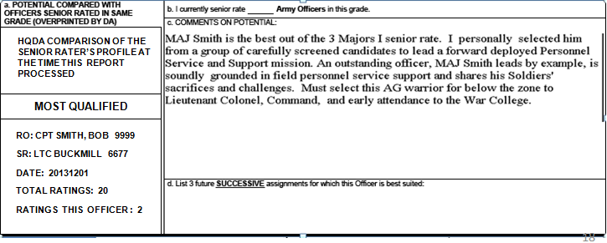
Completed Senior Rater Section
3
MAJ Smith is the #1 of the 3 Majors I senior rate. Personally selected to lead a forward deployed Personnel Service and Support Mission. A grounded leader who shares in his Soldiers’ sacrifices and challenges. Must select below the zone to LTC, Command and early attendance at the War College
RO: MAJ SMITH, BILL 9999
BN CDR; Division G1, DA G1 Staff
Reinforcing Rules:
First single top box at a given grade will generate an MOST QUALIFIED label at DA, regardless of profile (of the first four OERs in a grade, by component, any one, but only one, can be an MOST QUALIFIED.)
Cannot mention box check in the narrative
Restarts by grade, with SR’s permission, after 3 reports and a documented misfire in that grade have been processed at HQDA
Notes:
This is what a DA Form 67-10 senior rater evaluation looks like in the OMPF. The wording reflects the box check comparison and its administrative information, the narrative, the three successive positions, and the HQDA label information.
Now lets cover the rules about how a profile labels your reports…

Slide 31
Managed Profile Technique
(the comparison of box check to SR profile)
SENIOR RATER BOX CHECK LABEL
67-9
HQDA COMPARISON OF THE SENIOR
RATER’S PROFILE AND BOX CHECK AT
THE TIME THIS REPORT PROCESSED
b. POTENTIAL COMPARED WITH OFFICERS SENIOR
RATED IN SAME GRADE (OVERPRINTED BY DA)
RULE 1
MOST QUALIFIED
HIGHLY QUALIFIED
Limited to less than 50%
X
HIGHLY QUALIFIED
RO: MAJ SMITH BILL XXXXXXXXX
QUALIFIED
SR: LTC BUCKMILL XXXXXXXXX
UNQUALIFIED
DATE: 20140401
TOTAL RATINGS: 20
RATINGS THIS OFFICER : 2
Regardless of profile
HQDA COMPARISON OF THE SENIOR
RATER’S PROFILE AND BOX CHECK AT
THE TIME THIS REPORT PROCESSED
b. POTENTIAL COMPARED WITH OFFICERS SENIOR
RATED IN SAME GRADE (OVERPRINTED BY DA)
MOST QUALIFIED
QUALIFIED
Limited to less than 50%
HIGHLY QUALIFIED
X
RO: MAJ SMITH BILL XXXXXXXXX
QUALIFIED
NOT REFERRED
SR: LTC BUCKMILL XXXXXXXXX
DATE: 20140401
UNQUALIFIED
TOTAL RATINGS: 20
RATINGS THIS OFFICER : 2
Notes:
The rules involved with the Managed Profile Technique follow:
Rule 1 : If you check a Highly Qualified (HQ) box or lower you will always get that label, regardless of your profile.
It is the total number of ALL reports added together which determine your profile for the next two rules – for selections of the MOST QUALIFIED box.

Slide 32
Managed Profile Technique
(the comparison of box check to SR profile)
Top block check gets ONE of two labels...
Process at DA
PROFILE IS
RULE 2
HQDA COMPARISON OF THE SENIOR RATER’S PROFILE AT THE TIME THIS REPORT PROCESSED
- Top block check labeled
“Most Qualified" when...
- profile is less than 50%
in top block
- Board sees only label and narrative
Top block check labeled
“highly qualified" when...
- profile is equal to or more
than 50% in top block
- Board sees only label and narrative
3 17 0 0 20
MOST QUALIFIED
TOTAL
RO: MAJ SMITH, BOB 9999
SR: LTC BUCKMILL 6677
b. POTENTIAL COMPARED WITH OFFICERS SENIOR
DATE: 20140401
RATED IN SAME GRADE (OVERPRINTED BY DA)
TOTAL RATINGS: 20
X
MOST QUALIFIED
RATINGS THIS OFFICER : 2
Limited to less than 50%
HIGHLY QUALIFIED
QUALIFIED
HQDA COMPARISON OF THE SENIOR RATER’S PROFILE AT THE TIME THIS REPORT PROCESSED
RULE 3
UNQUALIFIED
Process at DA
PROFILE IS
HIGHLY QUALIFIED
RO: MAJ SMITH, BOB 9999
SR: LTC BUCKMILL 6677
10 10 0 0 20
DATE: 20140401
TOTAL RATINGS: 20
TOTAL
RATINGS THIS OFFICER : 2
Notes:
Remember: The Managed Profile Technique requires that a senior rater maintain less than 50% of all reports written, separated by rank, with a (MOST QUALIFIED) box check to retain an MOST QUALIFIED label.
Rule 2 (moving across the top half of this slide): If a report arrives at HQDA with a top box selection, and it causes a profile percentage of less than 50% in the top box, it will be labeled MOST QUALIFIED. In this situation this is the 3d report received with a top box selection with a total of 20 reports. 3 of 20 is clearly less than 50%. This report will receive an MOST QUALIFIED label and add to the MOST QUALIFIED quantities.
Rule 3 (moving across the bottom half of this slide): If a report arrives at HQDA with a top box selection and it creates a profile percentage of 50% or greater it will be labeled HQ. In this situation this is the tenth report received with a top box selection with a total of 20 reports (10 of 20 is 50%). This report will receive a HQ label but will still be added to the MOST QUALIFIED quantities.
-This is “misfire” situation – a top box (MOST QUALIFIED) selection/HQ label. We can send letters of notification to senior raters through their chains of command when this occurs. More importantly, and why senior raters do not want to misfire, this OER reflects a HQ label but senior rater profile builds in MOST QUALIFIED column (based on its box check).
To avoid a potential misfire we notify SENIOR RATERS in the EES that they may misfire. This warning occurs when the box check is made and when the Senior Rater Signs the evaluation. When that warning shows, if you believe it to be wrong, DO NOT SUBMIT.. Verify your profile with HQDA in accordance with the warning. Most potential misfires are created due to submission sequencing problems.

Slide 33
Managed Profile Technique
(the comparison of box check to SR profile)
Example of the EES Warning
Senior Rater Misfire warning for 67-10-1/2 with Most Qualified indication.
CONDITION: Senior Rater is making a "Most Qualified" indication on the 67-10-1/2 Form (WO1-LTC) in the Evaluation Entry System (EES). The system (EES) calculates an indication of MOST QUALIFIED will result in a MISFIRE:
MISFIRE DEFINITION = (#Most Qual/Total #reports is equal to or greater than 50%)
“YOUR SELECTION OF “MOST QUALIFED” MAY RESULT IN A DOCUMENTED "MISFIRE" AS YOUR SENIOR RATER PROFILE DOES NOT SUPPORT. YOUR SENIOR RATER PROFILE IS ACCURATE AS OF (SYSTEM DATE TIME=NOW). IF EVALUATION REPORTS HAVE BEEN SUBMITTED BY ALTERNATE METHODS (e.g. MAIL, SIPR OR NIPR) AND THE RATED OFFICER’S NAME WITH THE MOST RECENT THRU DATE IS NOT INCLUDED ON YOUR PROFILE, HRC HAS NOT RECEIVED OR PROCESSED THAT EVALUATION. ONCE RECEIVED AND SUCCESSFULLY PROCESSED, THE RATED OFFICERS NAME WILL BE INCLUDED IN YOUR PROFILE AND YOUR MOST QUALIFIED BOX CHECK MAY BECOME AVAILABLE. BY SUBMITTING THIS REPORT, YOU UNDERSTAND THAT THIS EVALUATION WILL RECEIVE A HQDA LABEL OF “HIGHLY QUALIFIED” AND DOCUMENTED AS AN “OFFICIAL MISFIRE” AND NOTICE MAY BE PLACED IN YOUR AMHRR. YOUR PROFILE WILL INCREMENT IN THE MOST QUALIFIED TOTAL AS INDICATED ON THE FORM AND WILL NOT BE COUNTED IN THE HIGHLY QUALIFIED TOTALS.
IF YOU HAVE OTHER EVALUATIONS TO PROCESS (MAIL OR ELECTRONIC) THAT WOULD ALLOW THIS REPORT TO PROCESS WITH THIS BOX CHECK, PROCESS THOSE FIRST.”
Notes:
This is an example of the warning you will see in EES if you select MOST QUALIFIED and your profile does not support.
** NOTE RATERS ARE NOT ALLOWED TO CHECK THE BOX TO CREATE A MISFIRE

Slide 34
Small Population / Immature Profile
SELECTION BOARD INSTRUCTIONS:
(1) Check DA label: “Total Ratings” (5 or less = immature profile)
  (2) Check Box in VIIa - same grade in population (3 OR LESS = Small Population)
  (3) Expect Highly Qualified
  (4) Focus on “Narrative”
Small Population
3
HQDA COMPARISON OF THE SENIOR RATER’S PROFILE AT THE TIME THIS REPORT PROCESSED
MAJ Smith is the #1 of the 3 Majors I senior rate. Personally selected to lead a forward deployed Personnel Service and Support Mission. A grounded leader who shares in his Soldiers’ sacrifices and challenges. Must select below the zone to LTC, Command and early attendance at the War College
HIGHLY QUALIFIED
RO: MAJ SMITH, BOB 9999
RO: MAJ SMITH, BILL 9999
SR: COL BUCKMILL 6677
DATE: 20140401
Immature
TOTAL RATINGS: 2
RATINGS THIS OFFICER : 1
1
Expect Highly Qualified – Use Narrative
Notes:
OK Now that you have seen the OER and the information within and how labeling works, we will cover how boards are instructed when interpreting labels
“Selection board members should focus on narratives, vice box checks alone.
The administrative information on the OER was specifically designed to assist selection board members quickly identify when a rated officer’s OER or senior rater is in a small population and/or immature (small) profile situation. Here is an example of how it works:
Look at the HQDA label at the “number of ratings” and you see that this is the senior rater’s second rating. This is an immature profile—immature is defined as numbers 1 thru 5. As you hear earlier, of the first four OERs a senior rater writes, any one, but only one, can be MOST QUALIFIED. The rest must reflect HIGHLY QUALIFIED (HQ). Many senior raters chose not to have any of their first four reports reflect as MOST QUALIFIED. You will see HIGHLY QUALIFIED (HQ) reports at least 75% of the time when the number is 1 through 5 here.
Now look at Part b (upper center) and you can see that it reflects a small population (any number of 3 or less). Examples of small populations are: one Army major in a Joint office, or one CW3 working in a battalion. When this number is small you know the senior rater is not going to be able to write a lot of reports that impact this profile. The rated officer may get an annual, another annual, and a change of rater. You can expect to see lots of back-to-back HIGHLY QUALIFIED (HQ) reports or MOST QUALIFIED to HIGHLY QUALIFIED (HQ) reports without a corresponding down-turn in performance reflected in the narrative. ”
I’ll show examples in the next slides to detect instances where selection board members’ using box checks alone could be misleading. To determine these circumstances you need to look at all the information in a senior rater section and that on other parts of the OER. This makes you consider, as you should, the entire senior rater section, the entire evaluation, successive evaluations in the file, and other information in the file in other words--the whole file concept. You should not use just one report or one element of any one report for your selection board member assessment.

Slide 35
Label Never Shows Downturn in Performance
1
SAME Senior Rater
MAJ Smith is the best Major I have seen in 25 years of service. Personally selected to serve at the Army level, MAJ Smith is articulate and possesses the vision to lead large and complex organizations. Must select below the zone to LTC, Command and early attendance at the War College
RO: MAJ SMITH, BILL 9999
SR: COL BUCKMILL 6677
TOTAL RATINGS: 1
RATINGS THIS OFFICER: 1
Battalion Command, Joint Staff, Brigade Command
Use
The
Narrative
1
HQDA COMPARISON OF THE SENIOR RATER’S PROFILE AT THE TIME THIS REPORT PROCESSED
MAJ Smith continues to be the best Major with whom I have served. A trusted leader and advisor whose critical thinking and analytical skills are already at a strategic level. Must select below the zone to LTC, Command and early attendance at the War College
HIGHLY QUALIFIED
RO: MAJ SMITH, BOB 9999
SR: BG BUCKMILL 6677
DATE: 20150401
TOTAL RATINGS: 2
RATINGS THIS OFFICER : 2
Battalion Command, Joint Staff, Brigade Command
Notes:
This situation shows two reports for the same officer and the same Senior Rater.
The first (at the top) shows an MOST QUALIFIED report and the second (at the bottom) shows a HIGHLY QUALIFIED. You might think that this is a down-turn of performance; but continue looking at the administrative data and narratives.
The first and second reports have the same senior rater (LTC-COL BUCKMILL) with 1 and 2 reports respectively
However both reports have small populations and the profile is still immature – expect Highly qualified and focus on the narrative.

Slide 36
Label Never Shows Downturn in Performance
10
Different Senior Raters
MAJ Smith is the #1 of the 10 Majors I senior rate. Personally selected to lead a forward deployed Personnel Service and Support Mission. A grounded leader who shares in his Soldiers’ sacrifices and challenges. Must select below the zone to LTC, Command and early attendance at the War College
RO: MAJ SMITH, BILL 9999
SR: COL BUCKMILL 6677
Battalion Command, Joint Staff, Brigade Command
Use
The
Narrative
10
HQDA COMPARISON OF THE SENIOR RATER’S PROFILE AT THE TIME THIS REPORT PROCESSED
MAJ Smith is the #1 of the 10 Majors I senior rate. A natural and confident leader whose judgment and vision surpass that of his peers. Select below the zone to LTC, select for Battalion Command and the Army War College
HIGHLY QUALIFIED
RO: MAJ SMITH, BILL 9999
SR: COL BOREK 6737
DATE: 20150401
TOTAL RATINGS: 02
RATINGS THIS OFFICER : 1
Battalion Command, Joint Staff, Brigade Command
Notes:
This situation shows two reports for the same officer.
The first (at the top) shows an MOST QUALIFIED report and the second (at the bottom) shows a HIGHLY QUALIFIED. Again, you might think that this is a down-turn of performance; but continue looking at the administrative data and narratives.
The first report has a senior rater (COL Buckmill) with 20 reports;
The second report has a senior rater (Col Borek) with 02 reports. Both have large rated populations but the NEW Senior Rater has an immature profile.
I’ll paint the picture that LTC Smith might be a new BCT commander who has a philosophy that rated officers have to work at least a year before he decides they meet his Above Center of Mass criteria. Different senior raters develop different numbers in their profiles. Focus on the narrative.
There are also situations when senior raters (particularly commanders) serve extended tours of duty and rated officers get a 3rd or 4th report (sometimes unanticipated from the outset) from the same senior rater. These reports box check may change over time. Watch the rest of the information and the narrative.

Slide 37
Evaluations Summary
Purpose of Evaluations: Identify our Army’s best performers and those with the greatest potential. They help:
Maintain discipline
Promote leader development/professionalism by linking performance to missions and doctrine (assessed by field leaders)
Provide feedback to rated individuals **counseling is critical
Leader must know how the system works, know when reports are due and have a rating philosophy
NARRATIVES - THEY ARE THE KEY to the system 99.008% of all Officers have at least one DA67-9 Center of Mass report and we expect use of Highly Qualified to remain consistent.
67-10 OERs:
- “Highly Qualified” ratings will be the norm
- Small populations/immature profile are common in any profile system
- Label never shows down-turn in performance.
Notes:
In summary for the OER system, I’d like to reemphasize a few key points.
Purpose of Evaluations: Identify our Army’s best performers and those with the greatest potential. They help:
Maintain discipline
Promote leader development/professionalism by linking performance to missions and doctrine (assessed by field leaders)
Provide feedback to rated individuals **counseling is critical
Leader must know how the system works, know when reports are due and have a rating philosophy
NARRATIVES - THEY ARE THE KEY to the system 99.008% of all Officers have at least one DA67-9 Center of Mass report and we expect use of Highly Qualified to remain consistent. They have always been the cornerstone of the OER system and in relaying the senior rater intent.

Slide 38
BACK UP

Slide 39
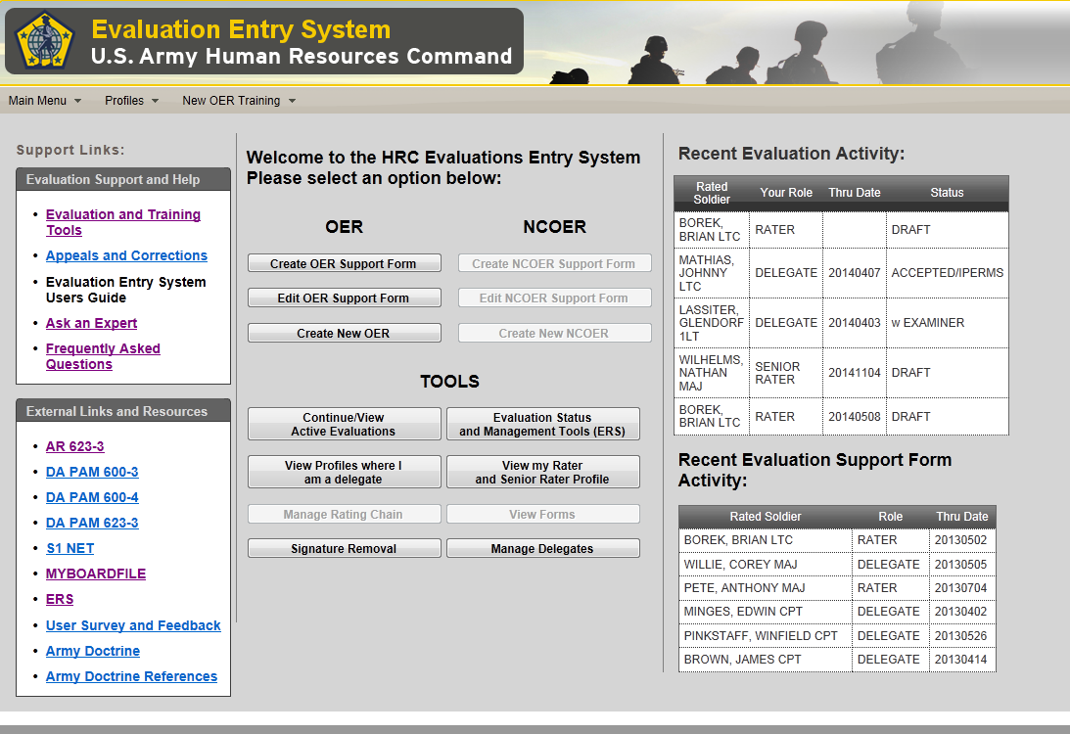
Evaluation Entry System – Landing Page
The Evaluations Entry System consolidates AKO MyForms, Army Forms, and reporting and tracking tools and profile monitoring from 4 different locations (websites) across the Army to one location
10 most current
Evaluations
Support links
Doctrine &
Regulations
10 most current
Support Forms
Notes:
This is the EES Landing page-

Slide 40
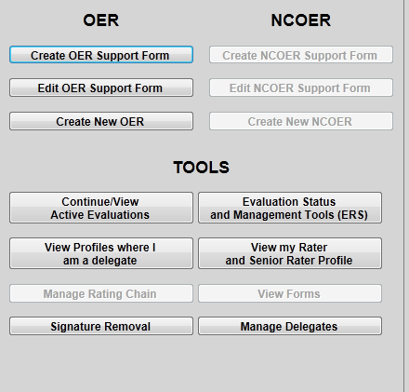
Evaluation Entry System – Landing Page
Center Section
Shows ALL active evaluations related to you as: Rater, Senior Rater, or Delegate.
Shows your Rater & Senior Rater Profile.
* Names associated with profile will be added at a later date – similar to the DASH 2 report
Allows delegates to view Rater or Senior Rater profile (if delegated).
Allows signature removal if correction or amendment is required
Allows Senior Rater or Rater to add Delegates who can draft, edit and submit reports on your behalf
DELEGATES CANNOT SIGN FOR YOU

Slide 41
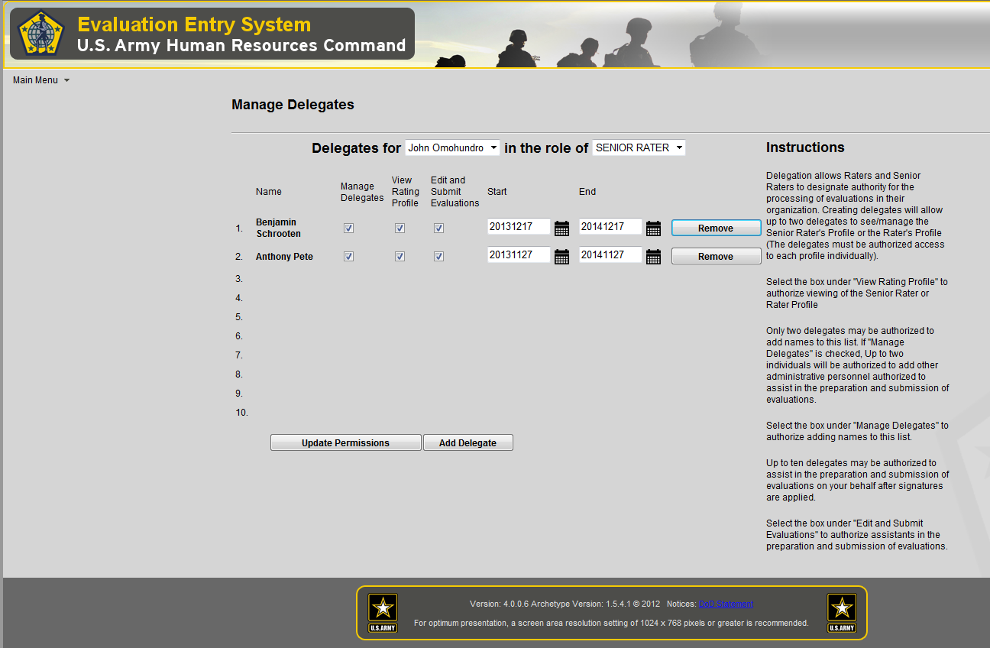
Manage Delegates
YOUR NAME
SGS, ADMIN
S1, 420 series,
PAC NCO or SGS
Evaluations Clerks, Other
Above the line allows 2 personnel who can add additional delegates,
View profile, edit and submit.
Below the line, allows visibility, edit and submit capability (once signed).
Unclassified

Slide 42
O-4 Broadening Experiences
Functional
ASCC
  OPS/Plans Officer
  WFF Chief
ASA/DCS
  Asst XO
  ADC
  Division Chief (BR/ FA Specific)
USACE
  DCO
ARCIC WFF Chief/Manager
AMC
  COCOM LNO
  OCLL LNO
CTC
  Senior OC-T
  JRTC Village Stability Director
AC/RC OC-T
DA/ASA/DCS
  Division Chief
  Director.
AWG (Forward Ops Chief)
TRADOC
  CAC WFF Chief/SME
Institutional
CIG Action Officer
SA/CSA/ASA/DCS
  Asst XO
  ADC
  Special Assistant
  Strategic Plans Officer
  AOC Action Officer
  Speech writer
DA Staff Asst XO
HRC Branch Chief
AWC Staff
CGSC Faculty
Recruiting Command HQs (BDE XO, S3)
TRADOC HQs (LNO, ARCIC Chief, DIV Chief)
CAC
  DIV Chief
  Doctrine Dev
  CDID Project Officer
  Exercise Officer
  Action Officer
ASCCs
  OPS/Plans Officer
Cadet Command HQs
USAREC HQs
1st Army/5th Army Staff
FORSCOM HQs
Academia & Civilian Enterprise
Fellowships
PMS/APMS
USMA Faculty/Staff
  Directorate
  BTO
Training With Industry
JIIM
AIDE TO PRES/VP
COCOM/Joint Staff Asst XO
COCOM HQs Commandant
UN Staff Officer
DCE Region OPS Officer
DOS Defense Trade Analyst
OSD
  Analyst
  Planner
  Emergency Ops officer Assistant
  Watch Officer
COCOM/Joint Staff
  Analyst
  OPS/PLANS/JOC
  WFF Chief
  Chiefs/Liaisons
  IA Liaisons
  Watch Officer
NORTHCOM Regional Support Chief
State IG
OCLL Liaison
Sister Service Faculty
TRADOC Sister Service LNO
Transition Team
Military Observer
Allied Program Manager
NGB Staff
CGSC IA Fellow
Unclassified

Slide 43
O-5 Broadening Experiences
Functional
ASCC
  OPS/Plans Officer
  WFF Chief
ASA/DCS
  Asst XO
  ADC
  Division Chief (BR/ FA Specific)
USACE
  DCO
ARCIC WFF Chief/Manager
AMC
  COCOM LNO
  OCLL LNO
CTC
  Senior OC-T
  JRTC Village Stability Director
AC/RC OC-T
DA/ASA/DCS
  Division Chief
  Director.
AWG (Forward Ops Chief)
TRADOC
  CAC WFF Chief/SME
Institutional
CIG Action Officer
SA/CSA/ASA/DCS
  Asst XO
  ADC
  Special Assistant
  Strategic Plans Officer
  Speech writer
DA Staff Asst XO
HRC Branch Chief
AWC Staff
CGSC Faculty
Recruiting Command HQs (BDE XO, S3)
TRADOC HQs (LNO, ARCIC Chief, DIV Chief)
CAC
  DIV Chief
  Doctrine Dev
ASCCs
  OPS/Plans Officer
Cadet Command HQs
USAREC HQs
1st Army/5th Army
IMCOM
CSA Strategic Studies Group
Army Strategic Planner
FORSCOM HQs
Academia & Civilian Enterprise
Fellowships
PMS/APMS
USMA Faculty/Staff
  RTO
  Instructor
  HQs/Staff
AWC Faculty
CGSC Faculty
JIIM
AIDE TO PRES/VP
COCOM/Joint Staff Asst XO
COCOM HQs Commandant
JCS Regional COCOM Desk Chief
OSD
  Analyst
  Planner
  Strategist
  Desk Chief
  POL-MIL Planner
  Military Assistant
  Speechwriter
COCOM/Joint Staff
  Division Chief
  TNG/Readiness
  OPS/PLANS/JOC
  WFF Chief
  Chiefs/Liaisons
  IA Liaisons
NORTHCOM Regional Support Chief
State IG
OCLL Liaison
Sister Service Faculty
TRADOC Sister Service LNO
Transition Team
Military Observer
Allied Program Manager
NGB Staff
Unclassified

Slide 44
O-6 Broadening Experiences
Functional
ASCC
  Division Chief
  Red Team
  OPS
  Plans
  IG
ASA/DCS
  XO
  Mil Assistant
  Division Chief (BR/ FA Specific)
USACE
  DCO
TRADOC Capabilities Mgr
AMC
  Command Directors
  PM
  COS
  XO
CTC COG
DA/ASA/DCS
  Division Chief
  Director.
Institutional
HRC CIG Chief
SA/CSA/ASA/DCS
  XO
  Mil Assistant
  Division Chief (BR/ FA Specific)
DA Staff XO
HRC DIV Chief
CAC Director
AWC Director
CGSC Faculty
Recruiting Command HQs
TRADOC HQs
CAC Director
  CAL
  COIN
  DTAC
  SAMS
ASCCs
  Division Chief
Cadet Command HQs
USAREC HQs
1st Army/5th Army
IMCOM
CSA Strategic Studies Group
Army Strategic Planner
FORSCOM HQs
Academia & Civilian Enterprise
SSC Fellowships
PMS
USMA Faculty/Staff
AWC Faculty
CGSC Faculty
SAMS Faculty
JIIM
AIDE TO VP
COCOM/Joint Staff XO
JCS Regional COCOM Desk Chief
OSD
  Analyst
  Planner
  Strategist
  Desk Chief
  POL-MIL Planner
  Military Assistant
COCOM/Joint Staff
  Division Chief
  TNG/Readiness
  OPS/PLANS
  IG
  Special OPS Chiefs/Liaisons
  IA Liaisons
DOS Desk Chief
AWC Director Joint Multi-national studies
CAC Joint Allied Studies
Defense Coordination Officer
State IG
OCLL Director/Liaison
ALSA Director
Sister Service Faculty
Allied PM Foreign Mil Sales
DISA DIV Chief
Unclassified

Slide 45
O-3 Broadening Experiences
Functional
ASCC
  OPS/Plans Officer
  WFF Chief
CTC
  OC-T
AC/RC
  OC-T
TRADOC
  SGL
  Training/Ops officer
INSCOM
  G2 Watch Officer
Institutional
CIG Action Officer
SA/CSA/ASA/DCS
  ADC
  Special Assistant
HRC
  Assignment Officer
  HQs
TRADOC
  Ops Officer
  Analyst
CAC
  Doctrine Dev
  Project Officer
  Officer
  Action Officer
ASCCs
  OPS/Plans Officer
USAREC
  Staff
  Company CMD
Academia & Civilian Enterprise
Fellowships
ACS
Training with Industry
APMS
USMA Faculty/Staff
  TAC
  Instructor
JIIM
JCS Intern
PEOC Watch Officer
OSD
  Watch Officer
Transition Team
Unclassified

